Slide 1
Audit Report
Importance of Contingent Liabilities, Letters from Client Lawyers and Subsequent Events

Slide 2
Contingent Liabilities
Liability that may occur as a result of an unforeseen event.
An estimated and relative amount of the contingent liability is recorded.
Disclosed as a footnote in the audit report.
Contingent liability includes warranties for products and law cases awaiting gearing (Karlsson & Strömqvist, 2019).
Notes:
According to Karlsson & Strömqvist (2019), a contingent liability is defined as a liability that is likely to occur considering the emergence of an unforeseen event. A contingency liability is bound to occur, and therefore an amount is estimated and recorded when making data entries. The estimated amount of the contingency liability should be reasonable. In addition, contingency liabilities are taken into consideration when preparing financial statements to ensure that they meet the requirements of the generally accepted accounting principles. Contingent liabilities are disclosed as footnotes in the financial statements (Karlsson & Strömqvist, 2019). An example of a contingent liability is a product warranty because the exact number of product returns is not known.

Slide 3
Importance of Contingent Liabilities
Helps in preparing for the future.
Essential for the budget-making process.
Key consideration while offering credit facilities.
Helps investors to determine possible liabilities (da Costa Marques, 2018).
Notes:
Taking into consideration contingent liabilities is a good practice for any company, government or institution because it helps in planning for the future (da Costa Marques, 2018). Contingency liability planning involves the ability to determine any unforeseen risk that the business, government, or institution may face in the future and then planning accordingly to prevent severe consequences. Considering contingency liabilities also assists in the budget-making process. Da Costa Marques (2018), noted that when contingency liability is taken into consideration, the relevant organization is able to set aside a reasonable amount to cover for the liability in case it occurs. Additionally, financial lenders must consider contingency liability while giving out credit liabilities to assess the viability of the company to repay the loan. Besides, investors, before making any investment, they must determine any liability that the investment may face. Contingency liabilities are one of the liabilities, and the investor is able to ascertain the viability of the investment.

Slide 4
Letters from Client Lawyers
Business letters received from the lawyers of the client.
Verifies any litigation information regarding the management of the company.
The auditor is able to know any pending legal information of the client.
Confirms the accuracy and legality of the information provided by the client (Mikhail, 2019).
Notes:
Letters from client lawyers are business letters that are sent by the lawyers of the client to the auditing firm. Using the information provided in the letters from the client lawyers, the auditor is able to verify any litigation information surrounding the management of the client's company. In addition, the letters from the client lawyers help the auditor to determine any pending legal information of the client, and that may result in a significant financial loss to the client (Mikhail, 2019). Besides, auditors are able to use the letters from the client lawyers to confirm whether the information provided by the client is legal and accurate.

Slide 5
Importance of Letters from Client Lawyers
Prevents confrontation with law enforcers.
Helps in preventing financial loss.
The auditor is able to determine the legitimacy of the client's business.
Clarifies any litigation doubts (Mikhail, 2019).
Notes:
Mikhail (2019), asserted that letters from client lawyers provide essential information pertaining to the business of the client. An auditing firm is able to use the information provided by the client lawyers to determine the legitimacy of the client's business. Letters from client lawyers may provide key information about the business, such as the federal tax identification number, license, and permit. Fulfilment of such business requirements prevents any confrontation with the law enforcers and ultimately prevents any financial loss to the client. In addition, whenever the auditor has any litigation doubts regarding the client's business, they request the letters from the client lawyers to prove such information (Mikhail, 2019).

Slide 6
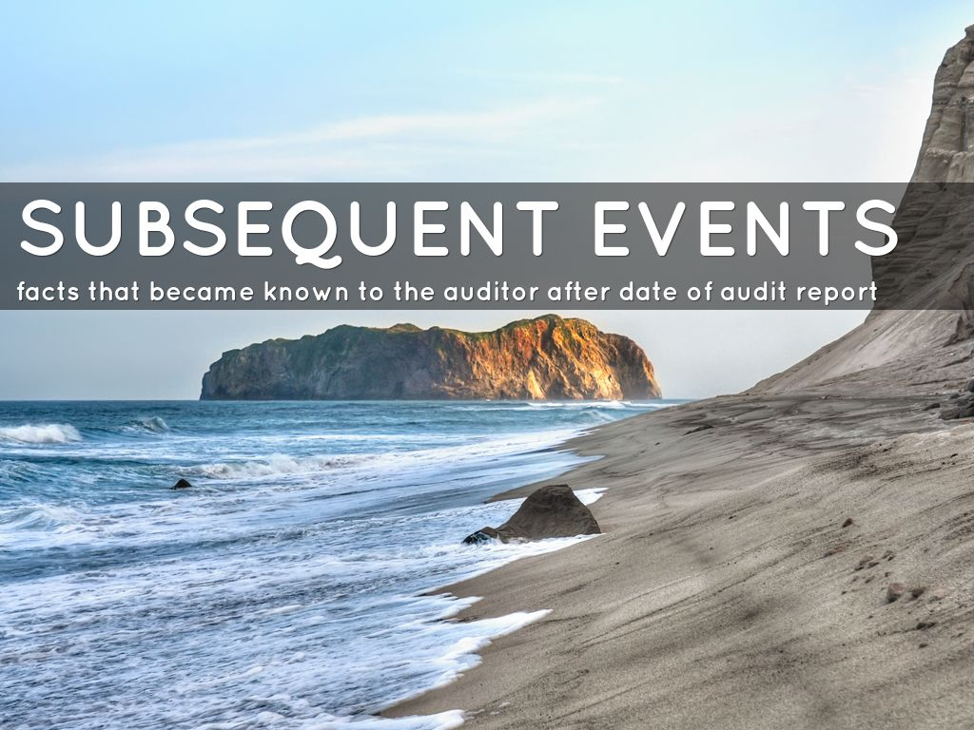
Subsequent Events
Events that occur after the audit report has been submitted.
Happens before the issuance of the financial statement.
Can be either an extra information or a new event.
Must be included in the financial statements (Phang & Fargher, 2019).
Notes:
Subsequent events are events that occur once the auditing firm has submitted the audit report and before the client releases the financial statements. As per the requirements of the generally accepted accounting principles, the consequences of subsequent events should be recorded in the financial statements (Phang & Fargher, 2019). Therefore companies should assess the subsequent events until when the company is ready to issue the financial statements. Subsequent events may be in the form of extra information or a new event. Extra information is whereby an event provides more information regarding a condition that already exists, while a new event is when the occurrence of an event offers totally new information concerning a condition that was never in existence.

Slide 7
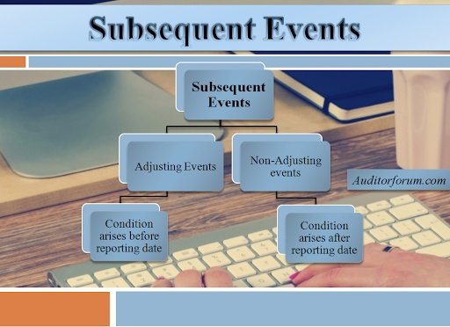
Importance of Subsequent Events
Provides appropriate evidence in financial statements.
Can change the financial position of the company.
Helps firms to attract more shareholders and investors (Lessambo, 2018).
Notes:
Subsequent events provide auditors with sufficient evidence regarding the extent to which events in both the financial statement and audit reporting date cause any change in the financial statements. Subsequent events justify any adjustment in the financial statement. In addition, subsequent events have the potential of changing the financial position of any organization. Some of the subsequent events, more so the new events, may drain the financial capability of a company (Lessambo, 2018). When a firm settles a legal case with an amount lower than an estimated liability, this is a plus in the balance sheet, and the firm is able to secure investors. Investors and shareholders look to analyze the balance sheet to determine the worthiness of any company.

Slide 8
Importance of Reviewing for Contingent Liabilities
To ensure that the contingency liability is not overstated.
To avoid scaring away creditors and investors.
To identify any tax liability that might not have been disclosed.
To protect the future of the company (Karlsson & Strömqvist, 2019).
Notes:
Firms or business organizations may look for investors or creditors at any time. For investors to pump money into any venture or creditors to give out any credit facility, they first analyze the financial statements of the corresponding company to assess its viability. Therefore, reviewing the contingency liabilities ensures that they are not overstated in the financial statements, something that may scare away potential creditors and investors. In addition, reviewing the contingent liability ensures that the auditor has identified any tax liability that, by any chance, was not disclosed (Karlsson & Strömqvist, 2019). Besides, reviewing the contingent liability ensures that all requirements have been met, and the contingent liability is well disclosed, and this guarantees the company a bright future because it would be able to access financial support from external sources.

Slide 9

Importance of Reviewing Subsequent Events
To identify all subsequent events that might have occurred.
To ensure that all subsequent events are disclosed.
To ascertain the correct data entry of subsequent events (Lessambo, 2018).
Notes:
The review of subsequent events ensures that all of them are identified. For instance, it is essential for auditors to review the contracts signed by the company to determine whether subsequent events like sales reversal or asset impairment might have occurred. Auditors have to ensure that all subsequent events that might have transpired between the time of financial statements and auditors report are sufficiently disclosed, and this is in accordance with the requirements of the generally accepted accounting principles (Lessambo, 2018). A subsequent event in contracts may alter the value in the financial statements. In addition, the review of subsequent events helps to identify whether the events have been entered into the correct accounts. For instance, settlement of pending lawsuit should be recorded in the legal fees expense account.

Slide 10
Requirements for Reviewing for Contingent Liabilities
A possible estimated value of the contingent liability.
A 50 percent chance of realization.
Possible contingency loss is disclosed as a footnote in the financial statement.
Treated as an expense in the income statement and liability in the balance sheet (da Costa Marques, 2018).
Notes:
When reviewing for contingent liabilities, it is a requirement that the contingent liability is assigned a value. Da Costa Marques (2018), asserted that contingent liability should also have at least a 50 percent chance of occurring or being realized. Ideally, if the contingent liability can be estimated, it means that it has high chances of occurring. Once the value has been estimated, it is recorded differently in the financial statements. The contingent liability is recorded as an expense in the income statement and as a liability in the balance sheet. A possible contingency loss whose amount is difficult to estimate is not captured in the accounts of the firm, but it is disclosed as a footnote in the financial statements.

Slide 11
Requirements for Reviewing for Subsequent Events
Only conduct procedures geared towards obtaining adequate audit evidence.
No review for matters in which previous procedures have yielded satisfactory results.
No procedure or adjustments to financial statements after the auditor's report.
Provision of a new report concerning adjusted financial statements (Phang & Fargher, 2019).
Notes:
While reviewing for subsequent events, the auditor is only required to conduct procedures aimed at obtaining adequate audit evidence of all relevant events that may require any disclosure or amendments in the financial statements. The auditor is also not allowed to conduct a review for previous subsequent events that had resulted in satisfactory results (Phang & Fargher, 2019). Upon submission of the auditor's report, the auditor is not required to make any adjustments or perform any procedure to the financial statements. In case of any crucial issue, the auditor should address the issue with the management and resolve for the best action. Besides, when the management agrees with adjustments in the financial statements, the auditor should service the management with the adjusted financial statements.

Slide 12
References
Karlsson, M., & Strömqvist, A. (2019). Contigent Convertibles-Liability or Equity? A study of the CoCo markets reaction to banks earnings announcements.
Da Costa Marques, M. D. C. (2018). New trends in public accounting in Portugal: the particular case of provisions, contingent liabilities, and contingent assets. In CSR and Climate Change Implications for Multinational Enterprises. Edward Elgar Publishing.
Mikhail, J. (2019). Is the Constitution a Power of Attorney or a Corporate Charter: A Commentary on a Great Power of Attorney: Understanding the Fiduciary Constitution by Gary Lawson and Guy Seidman. Geo. JL & Pub. Pol'y, 17, 407.
Phang, S. Y., & Fargher, N. L. (2019). Auditors' Evaluation of Subsequent Events: The Effects of Prior Commitment and Type of Accountability. Auditing: A Journal of Practice & Theory, 38(3), 167-182.
Lessambo, F. I. (2018). Subsequent Events; and Going Concern. In Auditing, Assurance Services, and Forensics (pp. 247-259). Palgrave Macmillan, Cham.

